Slide 2
Building Office Add-ins using Node.js
3-699
Jeremy Thake
Microsoft
@jthake
Andrew Connell
MVP
@andrewconnell

Slide 3
Developer vision
USERS
DATA
HTML

Slide 4
Topics
What is Node.js? … and io.js?
Developer Tooling for Node.js
Creating Websites & Web APIs with Node.js
Developing with Node.js
Node for Office & SharePoint Add-ins

Slide 5
What is Node.js?

Slide 6
What is Node.js
Cross platform environment for hosting JavaScript
Facilitates end-to-end JavaScript environment
Ideal for network & I/O based applications
Non-blocking, event driven
Open source
Managed by
Node.js Foundation
Joyent
https://nodejs.org

Slide 7
Who uses Node.js?
Microsoft Azure - http://aconn.me/1HZWEl2
Yammer - http://aconn.me/1Gxy9hL
Walmart - http://aconn.me/1HZWz0w
PayPal - http://aconn.me/1DsFZqx
LinkedIn - http://aconn.me/1NZNs1S
Trello - http://aconn.me/1OjCPsI

Slide 8
Node.js Components
Node
NPM
V8

Slide 9
Node.js vs io.js
Node.js – https://nodejs.org
Managed by Node.js Foundation (+Joyent)
Current (v0.12.2) uses V8 v3.28.73
io.js - https://iojs.org
Forked copy of Node.js in late 2014
Created out of community frustrations with decline in the pace of contributions & releases - http://aconn.me/1NZQvHl
Current version (v1.6.4) uses V8 v4.1.0.27
Contains many fixes & features not yet implemented in Node.js
Compatible with NPM
What will the future hold? Yet to be determined!

Slide 10
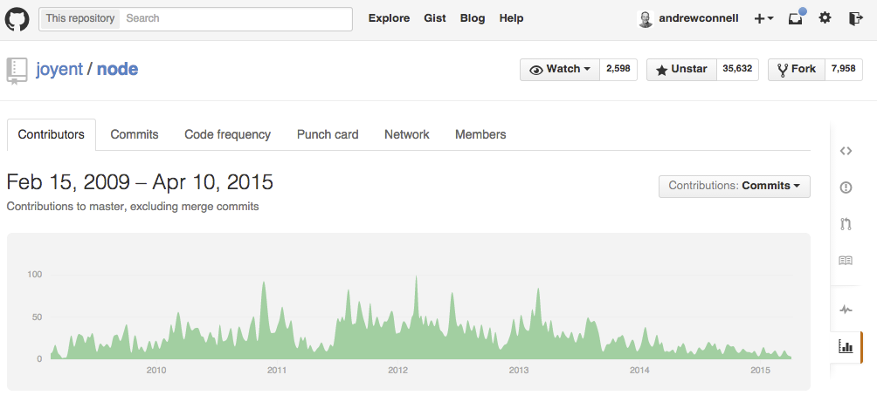
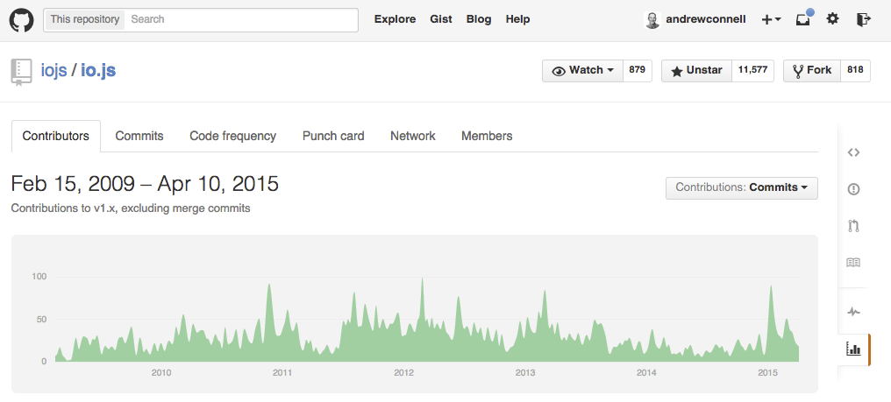

Slide 11
Appeal of Node.js & io.js
One language used from server to client
Same language used in projects & ecosystem around the projects
Build process
Developer tooling
System configuration
Cross platform
Built for network & I/O bound operations

Slide 12
Developer Tooling for Node.js

Slide 13
Node.js Developer Tooling Options
Visual Studio
Node.js Tools for Visual Studio
https://www.visualstudio.com/en-us/explore/node-js-vs
WebMatrix
http://www.microsoft.com/web/webmatrix
WebStorm
https://www.jetbrains.com/webstorm
Brackets
Open source – written in JavaScript & Node.js!
http://brackets.io
Any text editor

Slide 14
Node.js for Websites & Web APIs

Slide 15
Developing Node

Slide 16
Node.js for Websites & Web APIs
Connect
Express
MVC
APIs

Slide 17
Connect
HTTP Middleware for Node.js
var app = connect();
Facilitates simple request & response
Extensible HTTP server framework using plugins
Plugins = Middleware
Code that is added as a stack
Incoming requests execute each middleware one-by-one
Continues until middleware doesn’t call next()
Use middleware by executing:
app.use(‘/foo’, function mw(req, res, next){next();});

Slide 18
Express
Minimalist web framework
Built on Connect
Unopionated
Developers write all the plumbing code
Extensible – multiple MVC framework options

Slide 19
MVC Frameworks in Node.js
Jade
Unique HTML shorthand syntax
EJS
Embedded JavaScript
Vash
Similar to ASP.NET’s Razor syntax
Handlebars
Same as client-side syntax

Slide 20
Debugging Node.js Applications
Node --debug
node-inspector
Nodemon
spy.js

Slide 21
Node.js for Office 365, Office Add-ins & SharePoint Add-ins

Slide 22
Office 365, Office Add-ins & SharePoint Add-ins
All extensibility in Office related products & platforms is web based
Websites, web applications & Web APIs
Underlying tech & platform irrelevant
Node.js, just like ASP.NET, is just another option

Slide 23
Node.js + Office - Things to Consider
No wizards
No “Connected Service Wizard”
Create Azure AD application via Azure Portal
No Office 365 / SharePoint SDKs
Some packages available in NPM & bower
Use REST APIs
Authentication Flow
If all client side – use Azure AD’s Implicit Flow & ADAL JS
If server side – use ADAL for Node.js

Slide 24
Call to Action
https://nodejs.org
https://iojs.org
Demos used in this session:
https://github.com/andrewconnell/pres-o365-node

Slide 25
Developer Program Launch
1 YEAR FREE
E-mail Newsletters
Free Developer Subscription
Free Training
Free Tools
Webinars
http://dev.office.com/devprogram

Slide 26
Call to action
Sign up for Developer Program
Check out the express talks
Collect your stickers at //build

